Slide 1
Decision Tree for classification
The decision tree Algorithm belongs to the family of supervised machine learning algorithms. It can be used for both a classification problem as well as for regression problem. The concept behind the decision tree is that it helps to select appropriate features for splitting the tree into subparts and the algorithm used behind the splitting is ID3(Iterative Dichotomies-3).
The goal of this algorithm is to create a model that predicts the value of a target variable, for which the decision tree uses the tree representation to solve the problem in which the leaf node corresponds to a class label and attributes are represented on the internal node of the tree.
In decision tree we have to keep in mind two things:
Entropy.
Information gain.

Slide 2
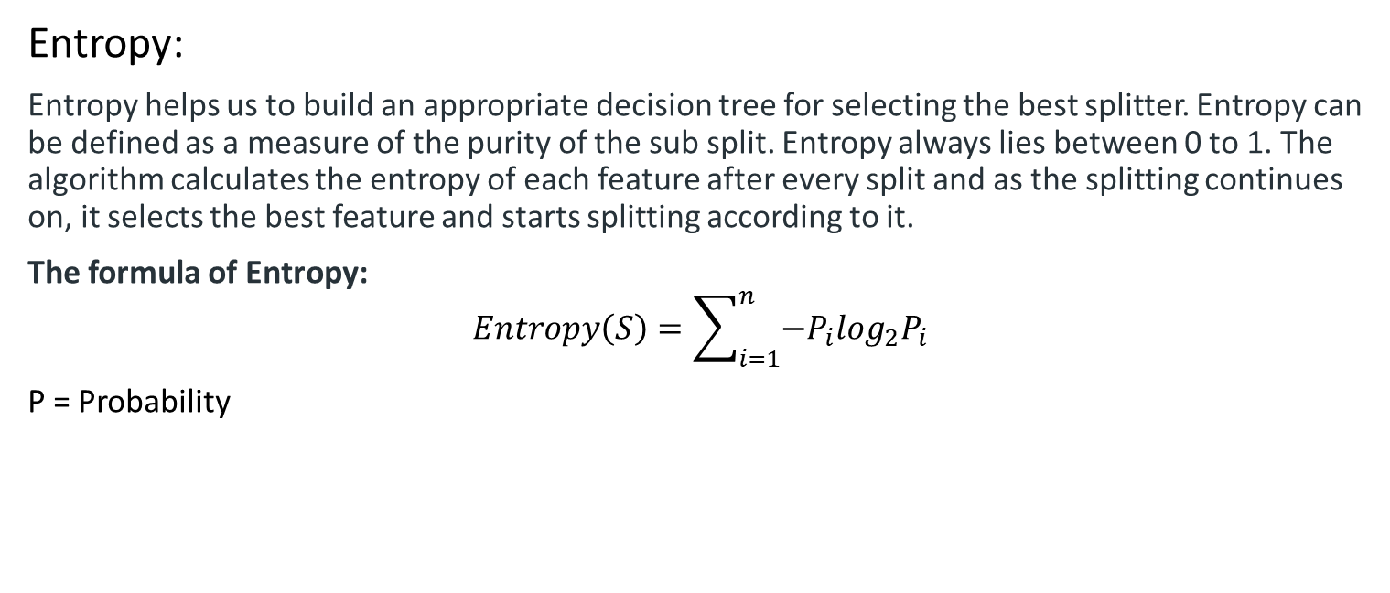
Decision Tree
Entropy:
Entropy helps us to build an appropriate decision tree for selecting the best splitter. Entropy can be defined as a measure of the purity of the sub split. Entropy always lies between 0 to 1. The algorithm calculates the entropy of each feature after every split and as the splitting continues on, it selects the best feature and starts splitting according to it.
The formula of Entropy:
$$Entropy\left(S\right)=\sum_{i=1}^{n}{−P_{i}\log_{2}P_{i}}$$
P = Probability

Slide 3
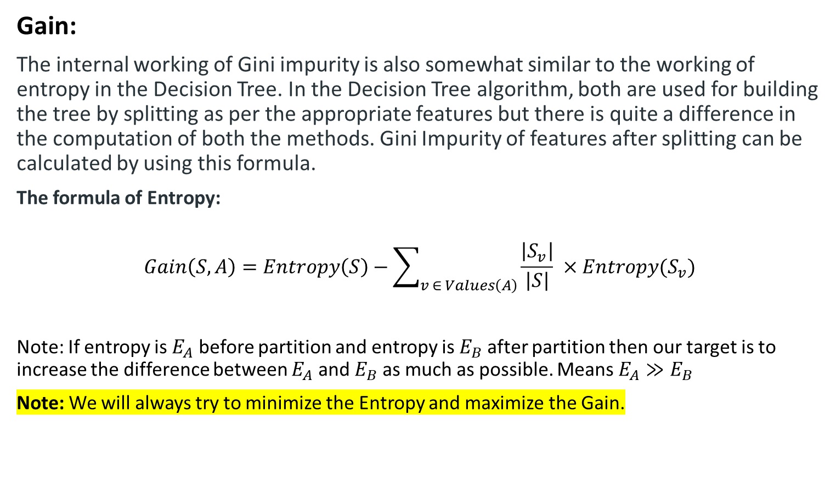
Decision Tree
Gain:
The internal working of Gini impurity is also somewhat similar to the working of entropy in the Decision Tree. In the Decision Tree algorithm, both are used for building the tree by splitting as per the appropriate features but there is quite a difference in the computation of both the methods. Gini Impurity of features after splitting can be calculated by using this formula.
The formula of Entropy:
$$Gain\left(S,A\right)=Entropy\left(S\right)−\sum_{v ∈ Values\left(A\right)}{\frac{\left|S_{v}\right|}{\left|S\right|}} ×Entropy(S_{v})$$
Note: If entropy is $E_{A}$ before partition and entropy is $E_{B}$ after partition then our target is to increase the difference between $E_{A}$ and $E_{B}$ as much as possible. Means $E_{A}≫E_{B}$
Note: We will always try to minimize the Entropy and maximize the Gain.

Slide 4
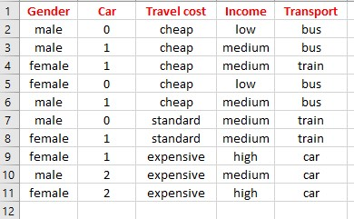
Decision Tree
Let’s try to understand how to make a decision tree using an Example:

Slide 5
Decision Tree
Iteration:1 and Root Selection
At first we have to find the root node of the decision tree. In our dataset four features and one target features. So, we have to find for gain for all four features. Which will give us the maximum gain we will choose that features as a root node.
Note: Before partition we have to find the entropy for target feature. In our target feature total number of data is ten and number of possible value is three that is bus, train, car. We will have to calculate entropy for each possible value.
Note: Gender column possible value is two that is male, female. Car column possible value is three that is 0, 1, 2. Travel cost column possible value is three that is cheap, standard, expensive. Income column possible value is three that is low, medium, high.
We will have to calculate each possible for each features based on the target column possible value.

Slide 6
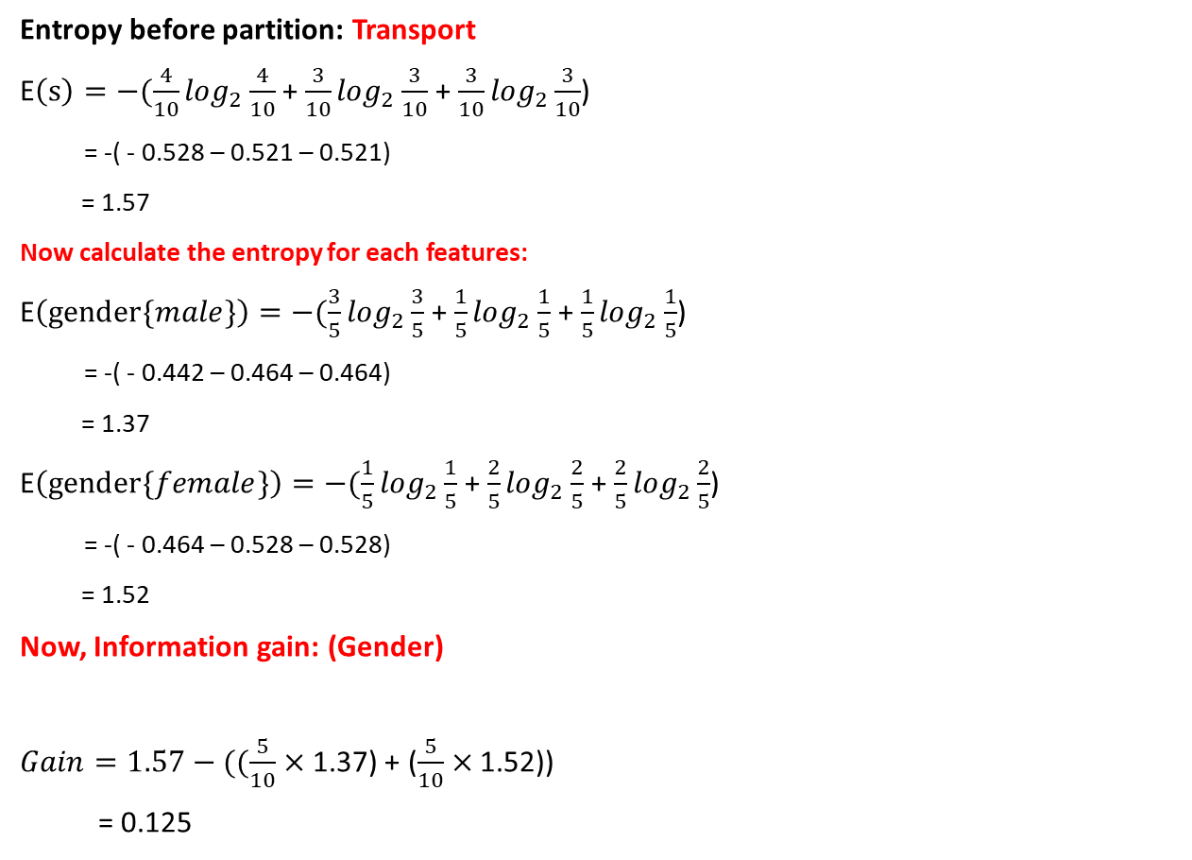
Decision Tree
Iteration-1
Entropy before partition: Transport
E$\left(s\right)=−(\frac{4}{10}\log_{2}\frac{4}{10}$ + $\frac{3}{10}\log_{2}\frac{3}{10}$ + $\frac{3}{10}\log_{2}\frac{3}{10}$)
= -( - 0.528 – 0.521 – 0.521)
= 1.57
Now calculate the entropy for each features:
E$\left(gender\{male\}\right)=−(\frac{3}{5}\log_{2}\frac{3}{5}$ + $\frac{1}{5}\log_{2}\frac{1}{5}$ + $\frac{1}{5}\log_{2}\frac{1}{5}$)
= -( - 0.442 – 0.464 – 0.464)
= 1.37
E$\left(gender\{female\}\right)=−(\frac{1}{5}\log_{2}\frac{1}{5}$ + $\frac{2}{5}\log_{2}\frac{2}{5}$ + $\frac{2}{5}\log_{2}\frac{2}{5}$)
= -( - 0.464 – 0.528 – 0.528)
= 1.52
Now, Information gain: (Gender)
$Gain=1.57−((\frac{5}{10}×$ 1.37) + ($\frac{5}{10}×$ 1.52))
= 0.125
Total data = 10
For 10 data possible
Bus=4, train=3, car=3
Total male = 5
For 5 male possible
Bus=3, train=1, car=1
Total female = 5
For 5 female possible
Bus=1, train=2, car=2
Total data = 10
For 10 data Male=5, Female=5

Slide 7

Decision Tree
Iteration-1
Now calculate the entropy for each features:
E$\left(car\{0\}\right)=−(\frac{2}{3}\log_{2}\frac{2}{3}$ + $\frac{1}{3}\log_{2}\frac{1}{3}$)
= -( - 0.387 – 0.528 )
= .915
E$\left(car\{1\}\right)=−(\frac{2}{5}\log_{2}\frac{2}{5}$ + $\frac{2}{5}\log_{2}\frac{2}{5}$ + $\frac{1}{5}\log_{2}\frac{1}{5}$)
= -( - 0.528 – 0.528 – 0.464)
= 1.52
E$\left(car\{2\}\right)=−(\frac{2}{2}\log_{2}\frac{2}{2}$)
= 0
Now, Information gain: (Car)
$Gain=1.57−((\frac{3}{10}×$ 0.915) + ($\frac{5}{10}×$ 1.52) + ($\frac{2}{10}×$ 0))
= 1.57 – (0.274 + 0.76 + 0)
= .537

Slide 8

Decision Tree
Iteration-1
Now calculate the entropy for each features:
E$\left(cost\{cheap\}\right)=−(\frac{4}{5}\log_{2}\frac{4}{5}$ + $\frac{1}{5}\log_{2}\frac{1}{5}$)
= -( - 0.257 - 0.464 )
= .721
E$\left(cost\{standard\}\right)=−(\frac{2}{2}\log_{2}\frac{2}{2}$)
= 0
E$\left(cost\{expensive\}\right)=−(\frac{3}{3}\log_{2}\frac{3}{3}$)
= 0
Now, Information gain: (Travel cost)
$Gain=1.57−((\frac{5}{10}×$ 0.721) + 0 + 0)
= 1.57 – 0.35
= 1.21

Slide 9

Decision Tree
Iteration-1
Now calculate the entropy for each features:
E$\left(income\{low\}\right)=−(\frac{2}{2}\log_{2}\frac{2}{2}$)
= 0
E$\left(income\{medium\}\right)=−(\frac{2}{6}\log_{2}\frac{2}{6}$ + $\frac{3}{6}\log_{2}\frac{3}{6}$ + $\frac{1}{6}\log_{2}\frac{1}{6}$)
= -( - 0.528 – 0.5 – 0.430)
= 1.459
E$\left(income\{high\}\right)=−(\frac{2}{2}\log_{2}\frac{2}{2}\text{)}$
= 0
Now, Information gain: (Income)
$Gain=1.57−((\frac{2}{10}×$ 0) + ($\frac{6}{10}×$ 1.459) + ($\frac{2}{10}×$ 0) )
= 1.57 – 0.875
= .695

Slide 10
Decision Tree
Attributes Gain
Gender 0.125
Car 0.537
Travel cost 1.21
Income 0.695
Travel cost
Expensive
Standard
Cheap
Car
Train
?
Bus or Train

Slide 11
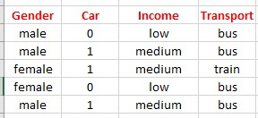

Decision Tree
Iteration-2
In second iteration we will work for only cheap so we can omit the Travel cost column.
Entropy before partition: Transport
E$\left(s\right)=−(\frac{4}{5}\log_{2}\frac{4}{5}$ + $\frac{1}{5}\log_{2}\frac{1}{5}$)
= -( - 0.257 – 0.464)
= 0.721
Now calculate the entropy for each features:
E$\left(gender\{male\}\right)=−(\frac{3}{3}\log_{2}\frac{3}{3}$)
= 0
E$\left(gender\{female\}\right)=−(\frac{1}{2}\log_{2}\frac{1}{2}$ + $\frac{1}{2}\log_{2}\frac{1}{2}$ )
= 1
Now, Information gain: (Gender)
$Gain=0.721−((\frac{2}{5}×$ 1) + 0)
= 0.321
Again same procedure:

Slide 12

Decision Tree
Iteration-2
In second iteration we will work for only cheap so we can omit the Travel cost column.
Now calculate the entropy for each features:
E$\left(car\{0\}\right)=−(\frac{2}{2}\log_{2}\frac{2}{2}$)
= 0
E$\left(car\{1\}\right)=−(\frac{2}{3}\log_{2}\frac{2}{3}$ + $\frac{1}{3}\log_{2}\frac{1}{3}$ )
= - ( - 0.389 – 0.528 )
= 0.917
Now, Information gain: (Car)
$Gain=0.721−((0)+(\frac{3}{5}×$ 0.917) )
= 0.721 – 0.550
= 0.170
Again same procedure:

Slide 13

Decision Tree
Iteration-2
In second iteration we will work for only cheap so we can omit the Travel cost column.
Now calculate the entropy for each features:
E$\left(income\{low\}\right)=−(\frac{2}{2}\log_{2}\frac{2}{2}$)
= 0
E$\left(income\{medium\}\right)=−(\frac{2}{3}\log_{2}\frac{2}{3}$ + $\frac{1}{3}\log_{2}\frac{1}{3}$ )
= - ( - 0.389 – 0.528 )
= 0.917
Now, Information gain: (Income)
$Gain=0.721−((0)+(\frac{3}{5}×$ 0.917) )
= 0.721 – 0.550
= 0.170
Again same procedure:

Slide 14
Decision Tree
Attributes Gain
Gender 0.322
Car 0.170
Income 0.170
Travel cost
Expensive
Standard
Cheap
Car
Train
Male
Female
0
1
Bus
Bus
Train

Slide 15

Full Calculation for one(before I calculate shortcut as you can seen):
E$\left(s\right)=−(\frac{4}{10}\log_{2}\frac{4}{10}$)
= -($\frac{4}{10}×\frac{\log_{2}\frac{4}{10}}{\log_{2}}$)
= -($\frac{4}{10}×\frac{\log\left(4\right)−log⁡(10)}{log⁡(2)}$)
= -(0.4 x -1.322)
= -( - 0.528)
= 1.57

Slide 16
Decision Tree for Regression
For decision tree regression the same formula use but here is slight different. In decision regressor threshold value consider and compare with threshold and also calculate the entropy and gain then make the decision tree. The decision criteria is different for classification and regression trees. Decision trees regression normally use mean squared error (MSE) to decide to split a node in two or more sub-nodes.

Slide 17
Decision Tree for Regression
Suppose we are doing a binary tree the algorithm first will pick a value, and split the data into two subset. For each subset, it will calculate the MSE separately. The tree chooses the value with results in smallest MSE value.
Let's examine how is Splitting Decided for Decision Trees Regressor in more details. The first step to create a tree is to create the first binary decision. How are you going to do it?
We need to pick a variable and the value to split on such that the two groups are as different from each other as possible.
For each variable, for each possible value of the possible value of that variable see whether it is better.
How to determine if it is better? Take weighted average of two new nodes (mse*num_samples)
To sum up, we now have:
A single number that represents how good a split is which is the weighted average of the mean squared errors of the two groups that create.
A way to find the best split which is to try every variable and to try every possible value of that variable and see which variable and which value gives us a split with the best score.
This is the entirety of creating a decision tree regressor and will stop when some stopping condition (defined by hyperparameters) is met:
When you hit a limit that was requested (for example: max_depth)
When your leaf nodes only have one thing in them (no further split is possible, MSE for the train will be zero but will overfit for any other set -not a useful model)

Slide 18
Decision Tree for Regression
How it makes predictions?
Given a data point you run it through the entirely tree asking True/False questions up until it reaches a leaf node. The final prediction is the average of the value of the dependent variable in that leaf node.

Slide 19
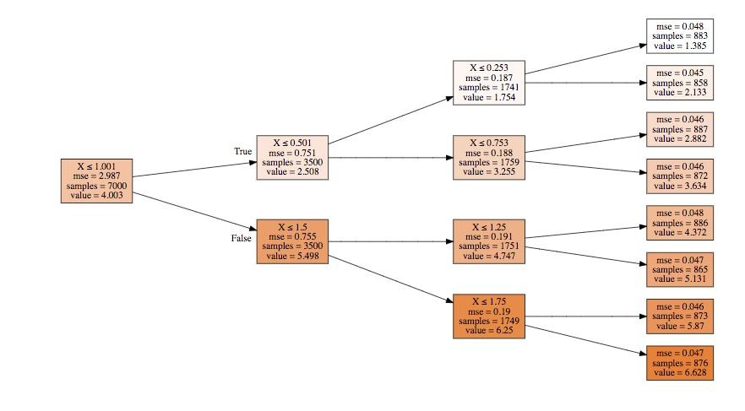
Decision Tree for Regression

Slide 20
Decision Tree for Regression
As you can see we're taking a subset of the data, and deciding the best manner to split the subset further. Our initial subset was the entire data set, and we split it according to the rule X<=1.001. Then, for each subset, we performed additional splitting until we were able to correctly predict the target variable while respecting the constraint of max_depth=3.
Scikit-learn use CART algorithm to create decision tree. In CART algorithm only produce binary tree means non-leaf nodes always two children.
ID3 algorithm also use for making decision tree. In id3 algorithm can create multiple child node or leaf node.

